Slide 1
Hands on Generative AI
Introducing attention
Notes:
Introducing attention
Many, many people talk about attention in AI, but have you ever wondered how the heck it works? Why does it work? and most importantly, why does it matter?

Slide 2

Attention
Introducing attention
We need to be able to provide good translations to an input text in, let’s say, Hungarian.
Notes:
To understand attention, in my humble opinion, I have to take you on a tour through history.
We are now in 2014, and the problem to solve is the one Globomantics has: Neural Machine Translation: We need to be able to provide good translations to an input text in, let’s say, Hungarian.

Slide 3
Introducing attention
I
like
attention
h1
h2
h3
context vector
RNN
RNN
RNN
/s
like
RNN
RNN
RNN
RNN
Ek
hou
van
aandag
Notes:
Back in the day, as you may have seen from the course TensorFlow Developer Certificate - Natural Language Processing (NLP), a traditional solution to the problem was using seq2seq models, or encoder decoder models, with RNN units with LSTMs. Exactly like the following picture:
In this image we have an RNN that takes as input vector the words in one language, and we took the final hidden state of this initial RNN as a context vector. This has all of the information of the whole text and its meaning. Think of it as reading a page you will translate, so you read it all, close it and now you have to remember it.
Then comes the decoder which is another RNN that takes as input the previous word and generates the next word. The important part is that the initial state of the RNN of the decoder is this context vector.

Slide 4
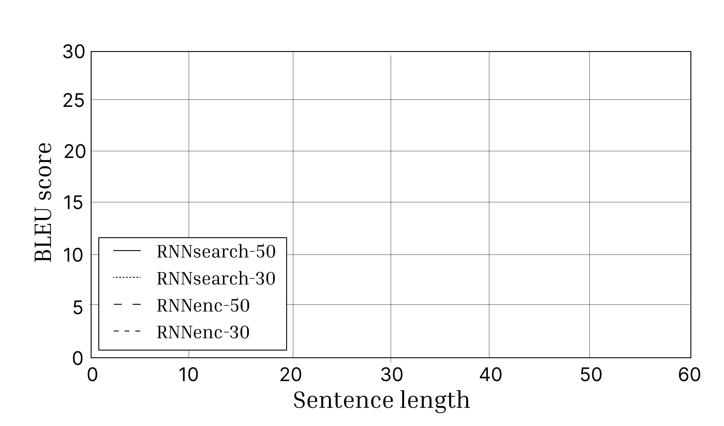
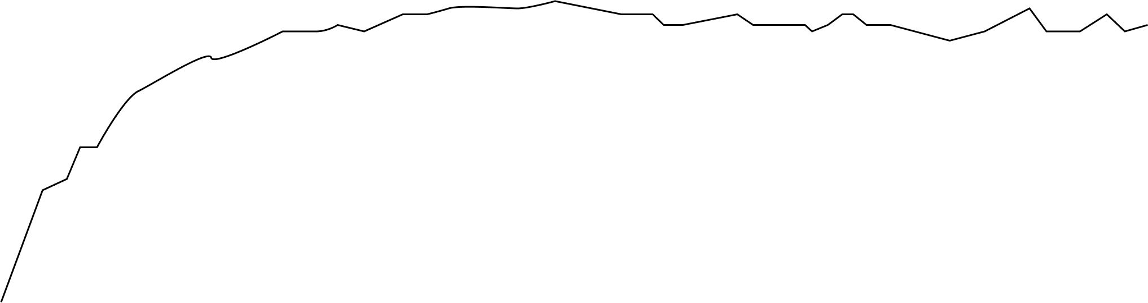
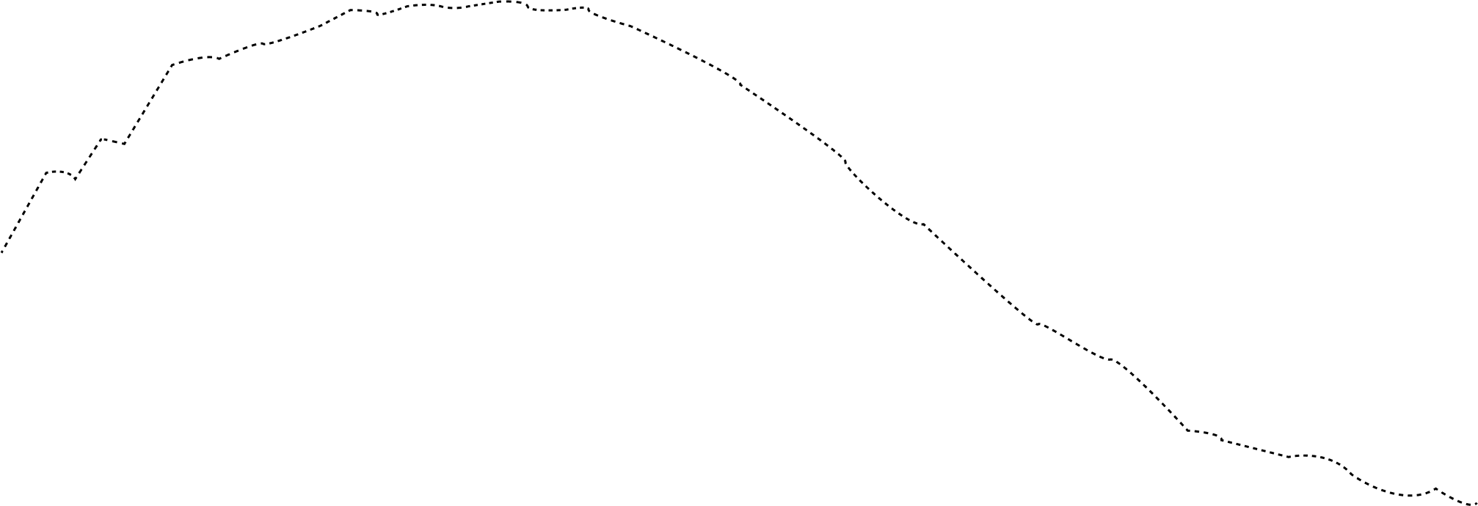
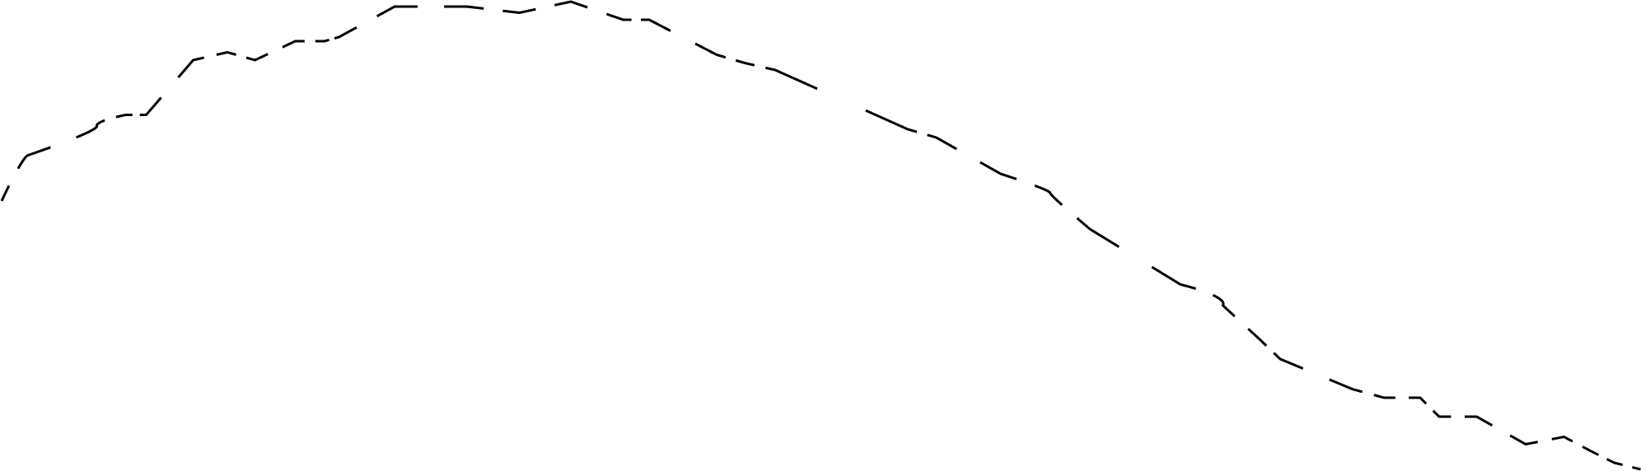
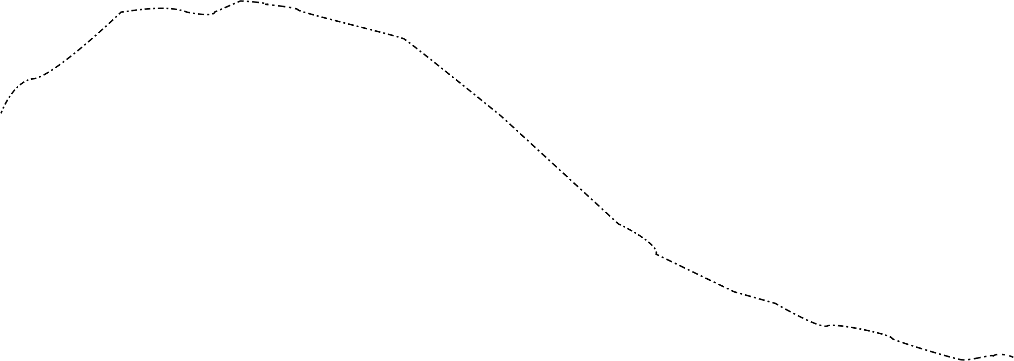
Introducing attention
Notes:
If I had to give you a similarity in real life, it would be this:
You want to translate from Spanish to English a given text, so you read it all, take it out, keep a single sentence as a reminder, and with that translate the whole thing. What will happen? Of course, it will start to fail as the sequence is longer because you cannot remember all of that long text in that single context vector. There is an informational bottleneck.
If you check the two curves that have dashes, you see exactly that, performance, measured in a metric called Blue score, went down when the sentence length increased. And what about the other 2? Well those included for the first time attention

Slide 5
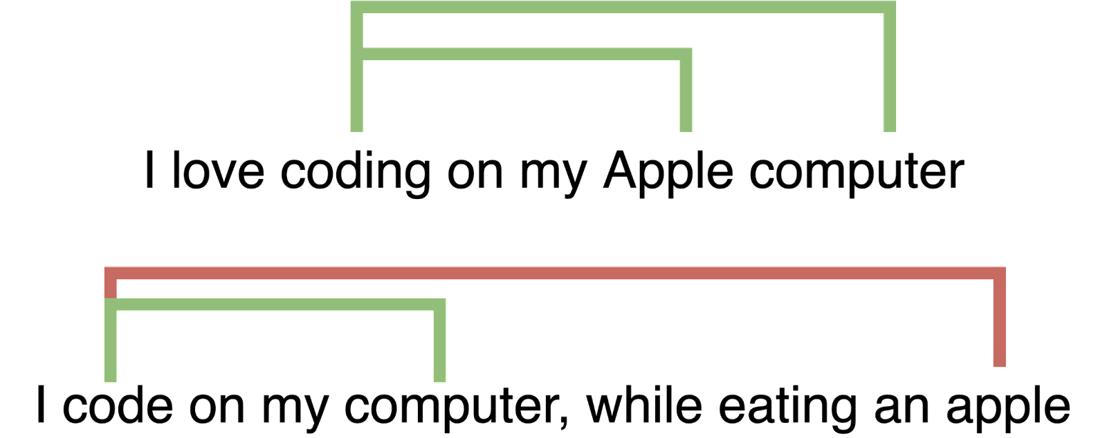
What is Attention?
Introducing attention
Notes:
And what is attention? It is the following idea:
Suppose we want to translate I love coding on my Apple computer, in that context, Apple has a strong alignment with coding and computer. Basically, we talk about the company. In the second sentence where we say that we are eating an apple, that alignment is nonexistent. What this means, is that for each generated translated word the context it has with each input word is different per step. As the previous seq2seq model had constant context, that is as Apple always meant the same.

Slide 6
Introducing attention
In math terms, this means that there exists a Tensor
$$a_{i,j}=f\left(h_{i},s_{j}\right)$$
Neural Machine Translation by Jointly Learning to Align and Translate by Bahdanau
They proposed the dot product
$$a_{i,j}=h_{i}^{T}∗s_{j}$$
We get a new tensor but the weights are not probabilities, so we get softmax
$c_{k}=softmax(\sum_{i}{a_{i,k}}∗h_{i}$)
Notes:
In math terms this means that there exists a Tensor:
ai,j= f(hi, sj)
where this function f determines how we can say this word is related to this other word at this point in time. In the original paper Neural Machine Translation by Jointly Learning to Align and Translate by Bahdanau et. al. they proposed the dot product, ie:
ai,j=hiT * sj
Once we have this Tensor of relationships we are done, for a given output word k, first we calculate the weights for each input word by projecting the alignments into the input tensor, and we get a new tensor but the weights are not probabilities, so we just run softmax:
ck = softmax(iai,k * hi)
And that exactly is represented in the following image:

Slide 7
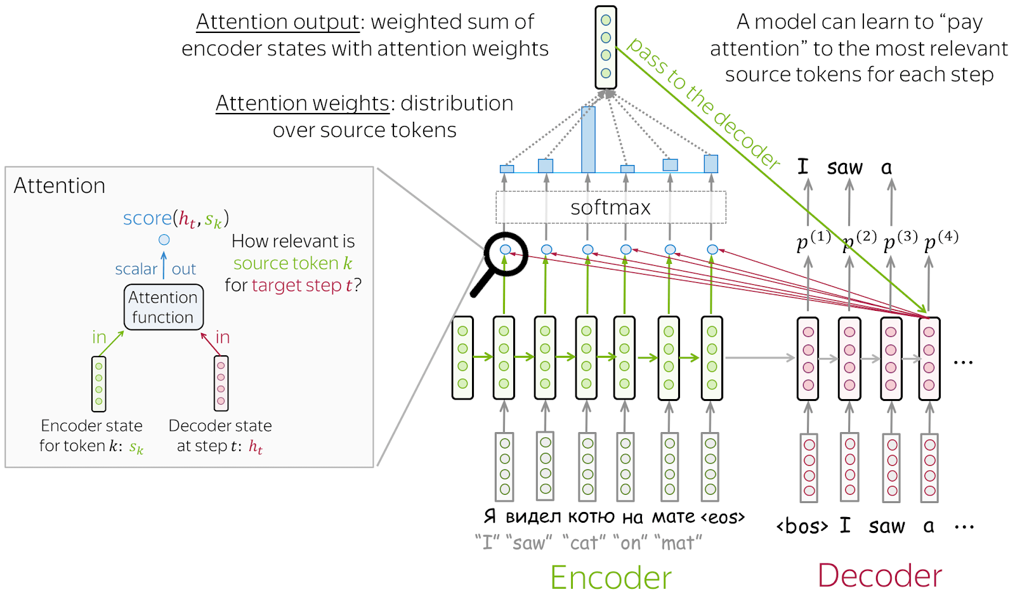
Introducing attention
Source: https://lena-voita.github.io/nlp_course/seq2seq_and_attention.html#attention_intro

Slide 8
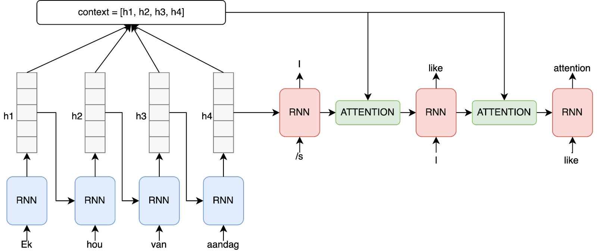
Introducing attention
Notes:
So, what do we gain? We gain that now at each output step we calculate the right context for that word with respect to the input, it is exactly as we do, for translating a word we look back and check the context to understand the exact translation. The final model looks like:
But that is enough about theory, first, let's get our feet wet by actually implementing attention and seeing is not that complex!

Slide 9

Lab
Introducing attention
Calculating attention by hand
Notes:
In this first demo, we will calculate attention by hand with just Numpy Arrays, to show that none of Tensorflow of Keras or magic is needed, it is just aligning words.

Slide 10
Before learning self-attention
Introducing attention
ID | Item | Price
1 | Shampoo | 4,99
2 | Conditioner | 2,99
Notes:
But before learning self-attention and KQV attention, we need to do a couple of slides. Imagine a database. In such a database, we can make a query. This query scans on the required fields and gets the ids of the rows to be returned, with that it returns the values.
For example in a table with the following info:
If we run the query SELECT PRICE FROM ITEMS WHERE ITEM = ‘Shampoo’ this query would run, the result of the alignment or similarity, of Shampoo with shampoo is 1 and with conditioner is 0. Therefore we could say the first output of that query is the following tensor: [1,0]
then the database uses that to return the final value: 4.99

Slide 11
Introducing attention
First, we will calculate the similarity between Q and K
$$a_{i,j}=similarity(\text{Q}\text{,}\text{K}\text{)}$$
Here we will have for each row many values different from zero, so later the output context vector is:
$$c_{i}=\sum_{i}{a_{i,k}}∗h_{i}$$
Notes:
In KQV, or Key, Query, and Value Attention, the idea is the same! We have some keys and values which are tensors. First we will calculate the similarity between Q and K
ai,j = similarity(Q,K)
The big difference with databases is that here the result instead of having only 1 value being 1 and the rest 0, we will have for each row many values different from zero, so later the output context vector is:
ci = jai,j * vj
That means the similarity matrix gives us the weights and then the output tensor is just a weighted sum of the values. Of course in the middle the similarity function will try to have a softmax such that apart from weights we have probability distributions.

Slide 12

Two Peculiarities
Introducing attention
K = V
This is why we say it is self-attention, because we do attention of the tensor with itself.
The similarity function is the following:
Notes:
As an example, in the Transformer, that means in scaled self attention we have two peculiarities:
K=V, this is why we say it is self attention, because we do attention of the tensor with itself.
The similarity function is the following:
Where d_k is the dimension of the embedding used. It is exactly the same dot product attention from before, we divide by a number and then it is just a softmax like we said. It is almost the simplest form of attention we can think of, and this is the one that created the Transformer. Cool right?
Back to the demo!

Slide 13
Lab
Introducing attention
Adding attention layers with frameworks
Notes:
In this final demo of the series, we will see how easy it is to build models using attention with Keras!

Slide 14
Recap: Seq2Seq with attention
Introducing attention
Notes:
And here we are! Now we are super prepared to implement the model that started the attention revolution, seq2seq with attention.

Slide 15
Introducing attention
Notes:
Just as a reminder, this is the model we are talking about:
In this model each input word needs to be translated, but we will construct the attention matrix based on the context hidden vectors and the output words. This means that at the start of sequence times this attention matrix will get me some weights on which word to choose. I select one and I go to the next word, this one has another set of weights with respect to the attention matrix, and therefore different weights to choose which word to choose.

Slide 16
There are many ways
Introducing attention
One is to pick the máximum probability – greedy search it is called and has one issue: it over picks simple words like the, a, and such
Another one is called beam search, which you can take as a homework to learn.
Finally, the one we will use is picked according to the distribution of probability, so maybe we don’t pick the highest scored word at a given point in time.
Notes:
Which word to choose there are many ways:
One is to pick the maximum probability - greedy search it is called and has one issue it over picks simple words like the, a, and such
Another one is called beam search, which you can take as homework to learn. I don’t want to make this module even longer!
Finally the one we will use is picked according to the distribution of probability, so maybe we don’t pick the highest scored word at a given point in time.

Slide 17
Introducing attention
Notes:
This model with different hyperparameter stands for the other two models in the following chart:
So you can see for example that this model with mode dimensions, 50, could easily outperform other models and maintain its performance for sentences over 50 words, which other models couldn’t. Let’s get to it, it’s going to be a tough ride!

Slide 18
Lab
Introducing attention
Implementing Neural Machine Translation with attention
Notes:
In this final demo of the module, we will implement the RNN50 model in Keras with all the components and effectively translate from Spanish to English, cool right?!

Slide 19

Summary
Transforming NLP
Attention is just a mechanism that enables for each output token to treat, get different personalized context
Dot product attention, being as simple as it is, is still able to detect relationships of words and is used in models nowadays
We have built a full encoder decoder model, for that we needed to create the necessary layers
These ideas actually generalise to any NLP task and pretty much everywhere. However after the next module that will become clearer
Notes:
This module has been all about setting the foundations on using Attention for the Transformer. Some takeaways are
Attention is just a mechanism that enables for each output token to treat, get a different personalized context
Dot product attention, being as simple as it is, is still able to detect relationships of words and is used in models nowadays
We have built a full encoder decoder model, for that we needed to create the necessary layers
These ideas actually generalise to any NLP task and pretty much everywhere. However after the next module that will become clearer

